Slide 1
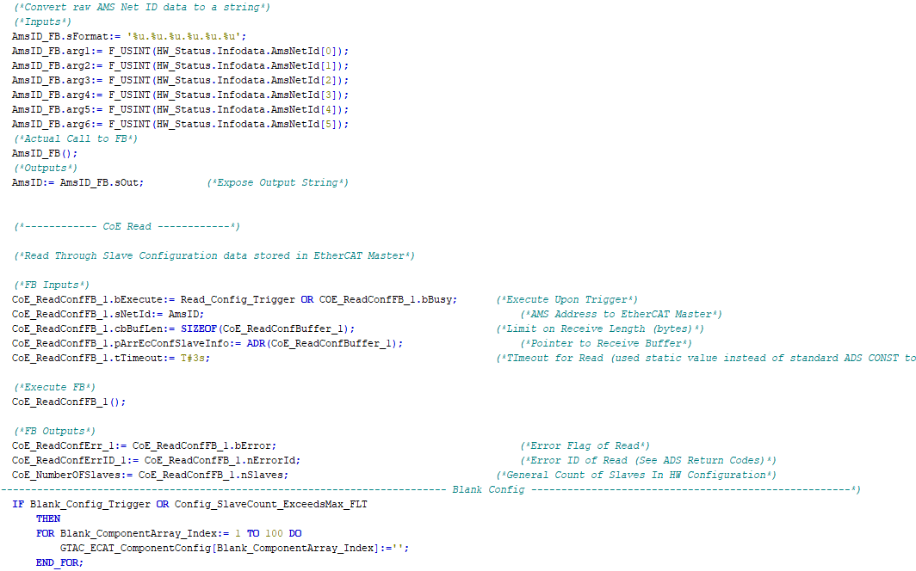

Internal Training:
TcHmi / SSCC610

Slide 2
Prerequisites
If you’re in this training session it means you have the following under your belt:
Setup of your local PC environment as per the IC Setup Guide contained in the SSCC610 machine package with:
XAE 4024.55 (in addition to .22)
TcHmi TE2000 (TcHmi Engineering)
TcHmi TF2000 (TcHmi Server)
Postgres / pgAdmin (Database / Database management tool)
Successfully deployed FW level SSCC610 locally on the above environment
TR7050 Beckhoff based training: Basics TwinCAT HMI

Slide 3



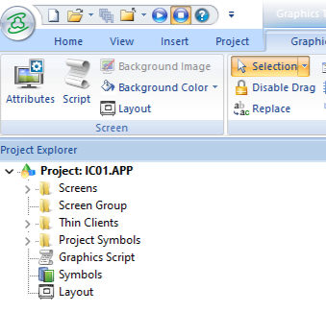
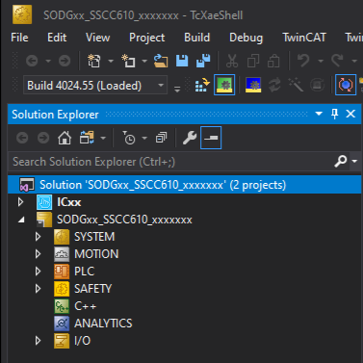
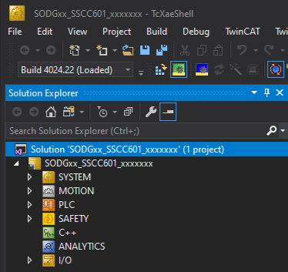
6.01 (IWS Based)
vs
6.10 (TcHmi Based)
FW SSCC6.01
Two different development environments
FW SSCC6.10
Same development environment

Slide 4
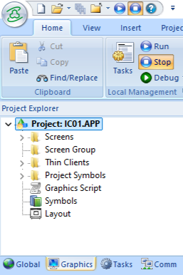
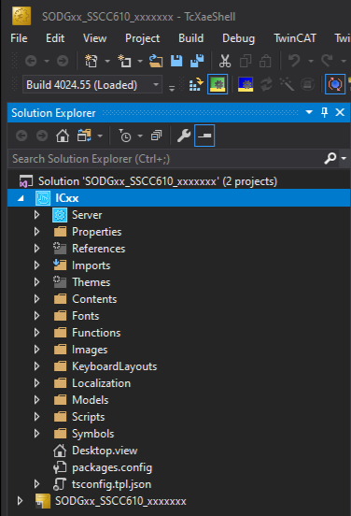
6.01 (IWS Based)
vs
6.10 (TcHmi Based)

Slide 5
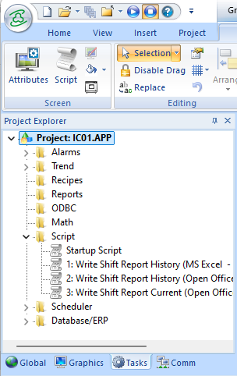
6.01 (IWS Based)
vs
6.10 (TcHmi Based)

Slide 6
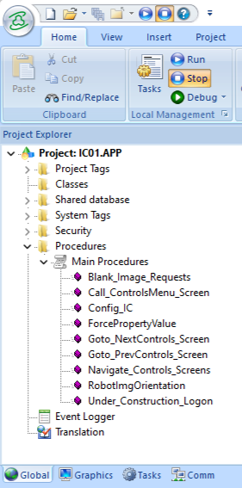
6.01 (IWS Based)
vs
6.10 (TcHmi Based)

Slide 7
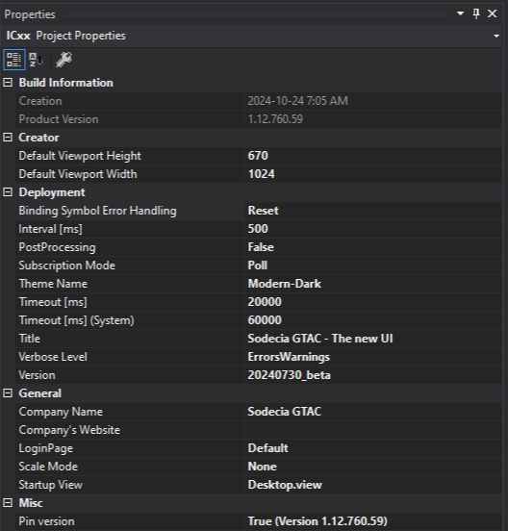
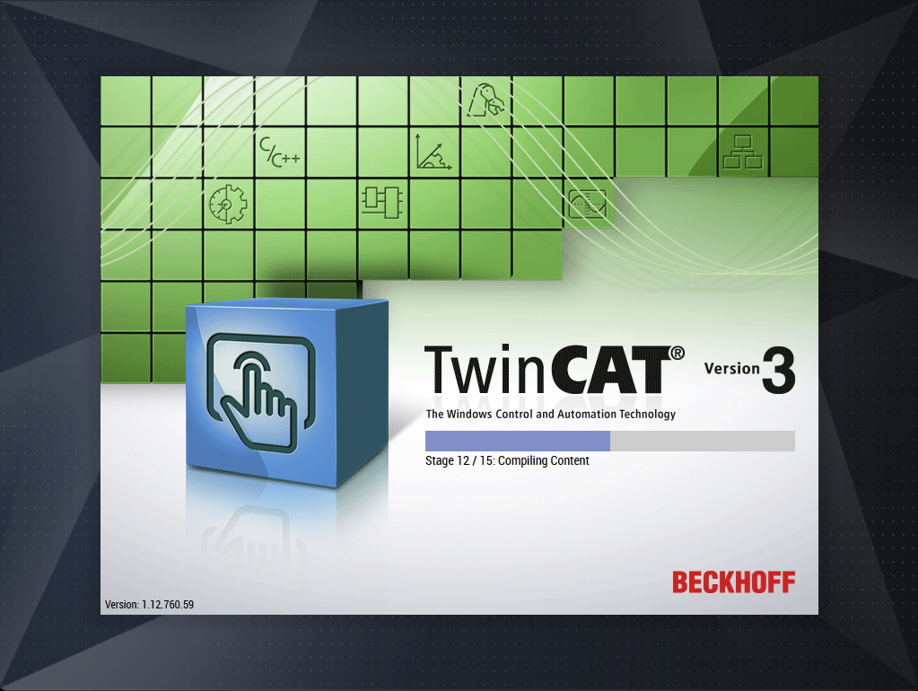

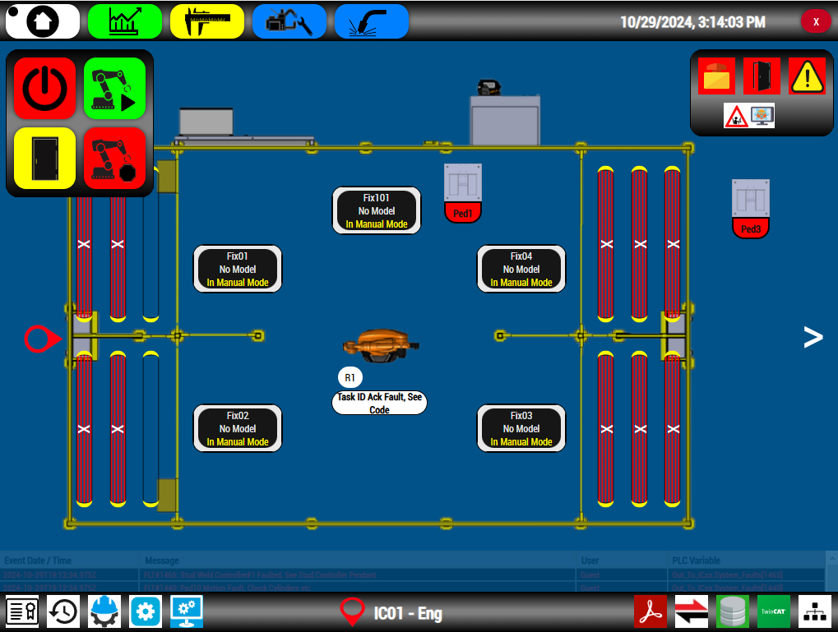
Navigation Concept

Slide 8
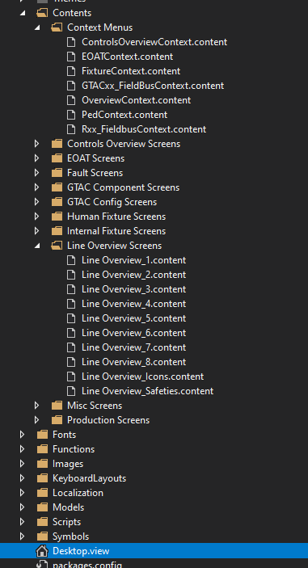
Navigation Concept
Context Region
Main Region

Slide 9
Navigation Concept

Slide 10
Navigation Concept
Clicking a navigation
object will change
the main region
and MAY also change
the content in the
context region

Slide 11
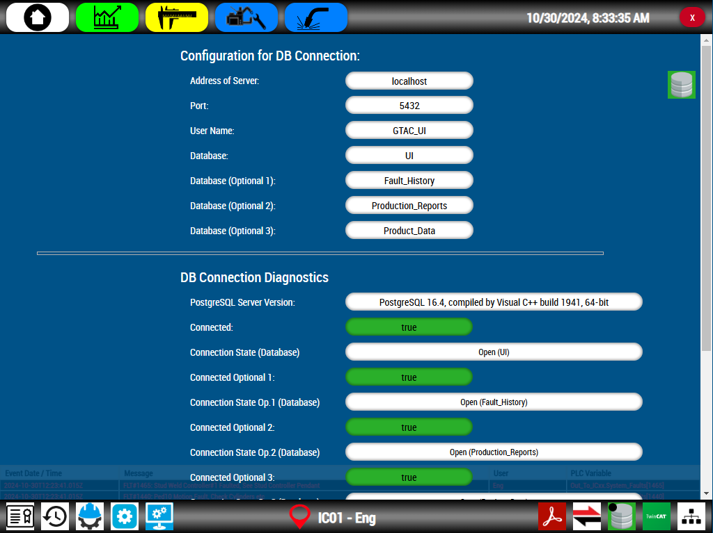
Navigation Concept
In this case (clicking the
database icon) only the
Main Region changed

Slide 12
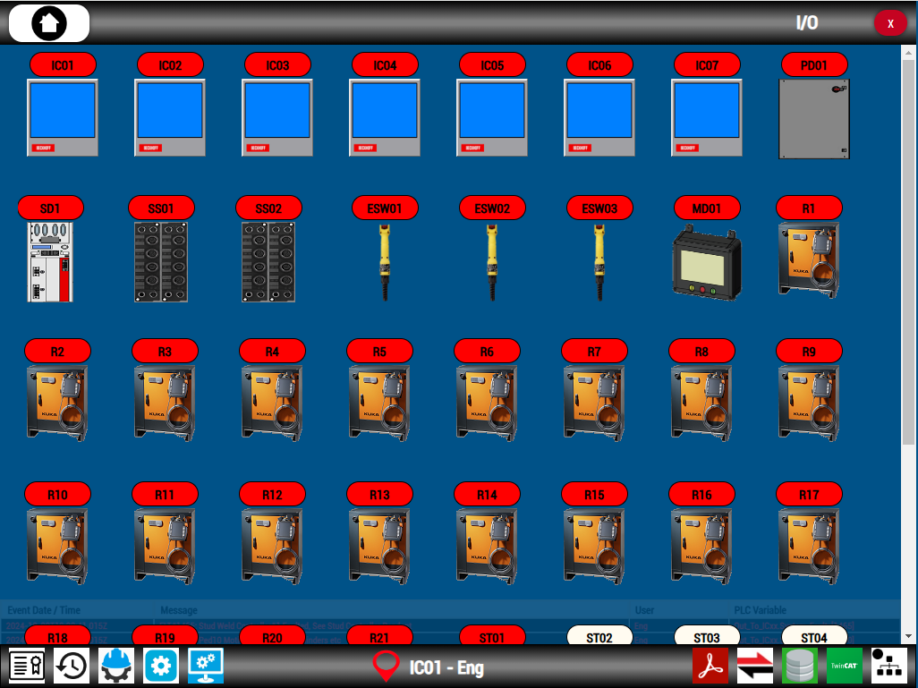
Navigation Concept
Alternatively, clicking the
network icon causes a
change to both
the Main Region and the
Context Region

Slide 13

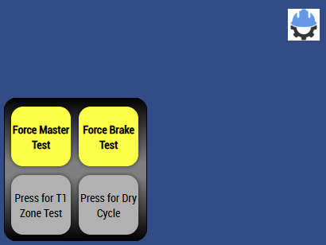

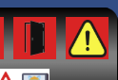
Line Overview Context Menu
Where did these go?

Slide 14
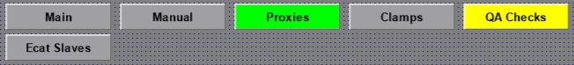
Fixture Context Menu

Slide 15
Robot Context Menu
Where did these go?

Slide 16
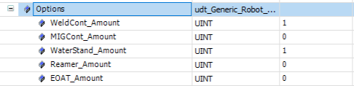
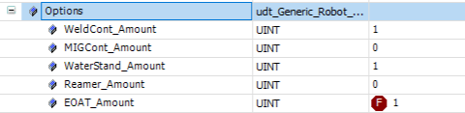
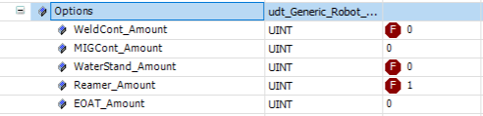
Robot Context Menu
This menu’s layout auto configures
based on PLC variables

Slide 17
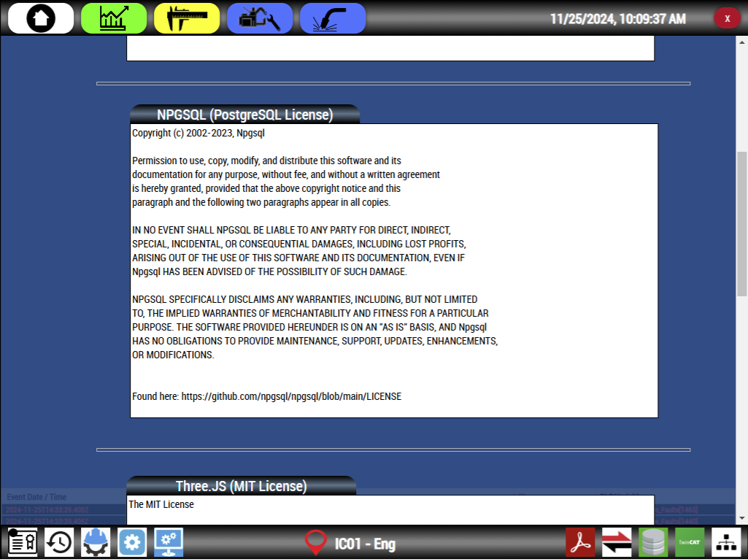
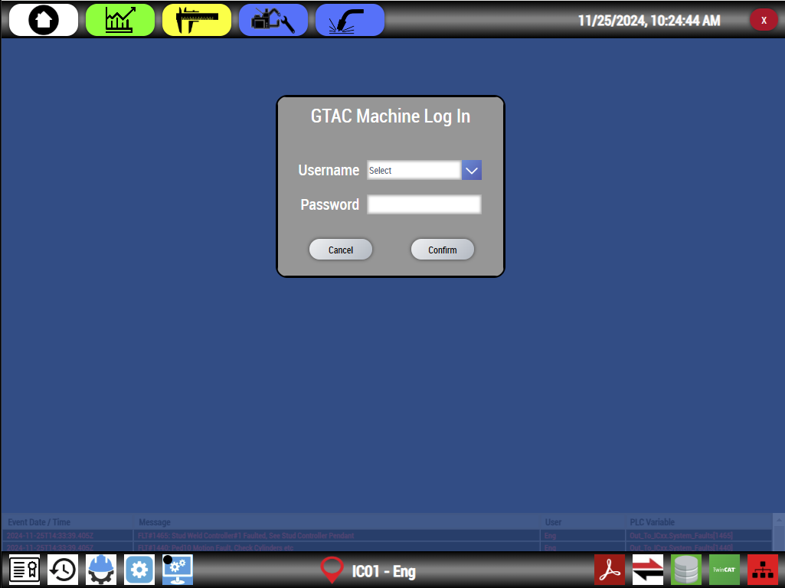
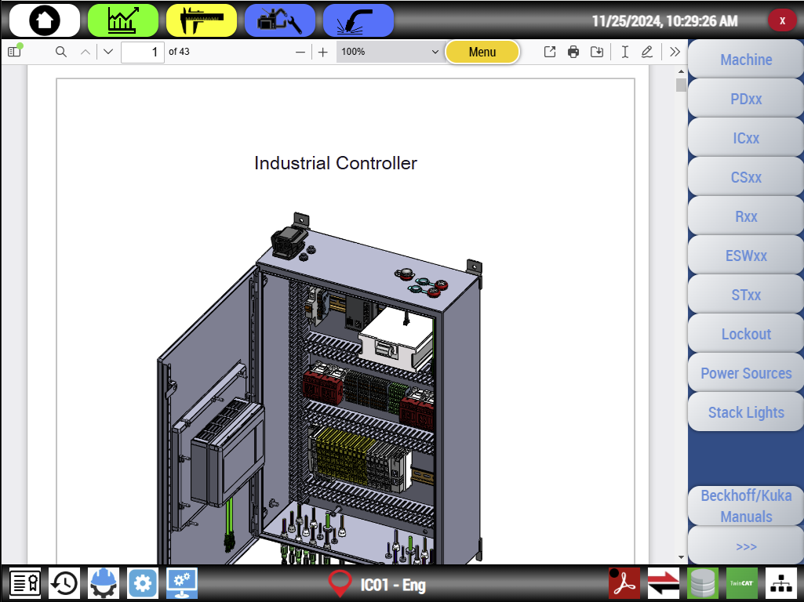
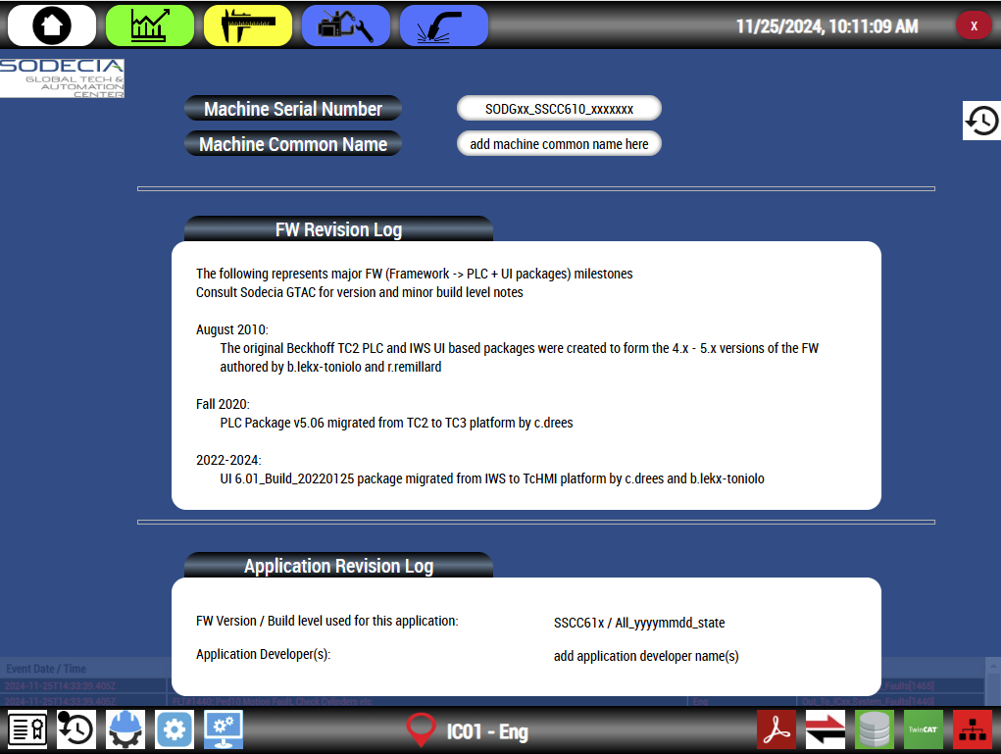
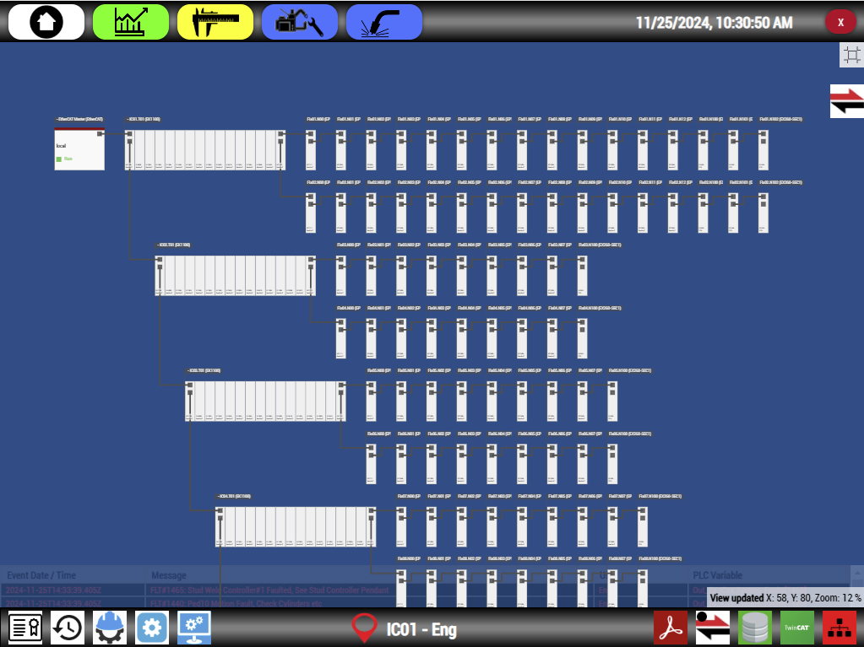
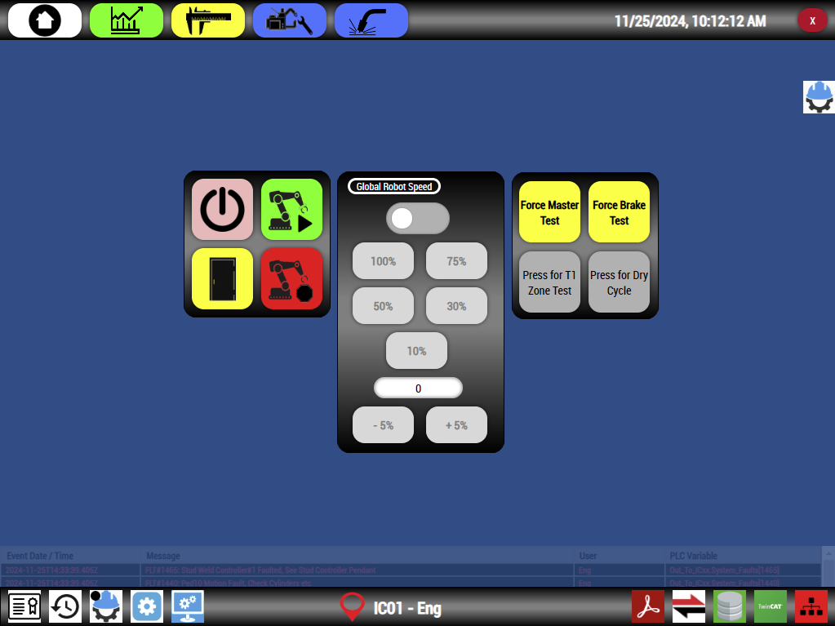
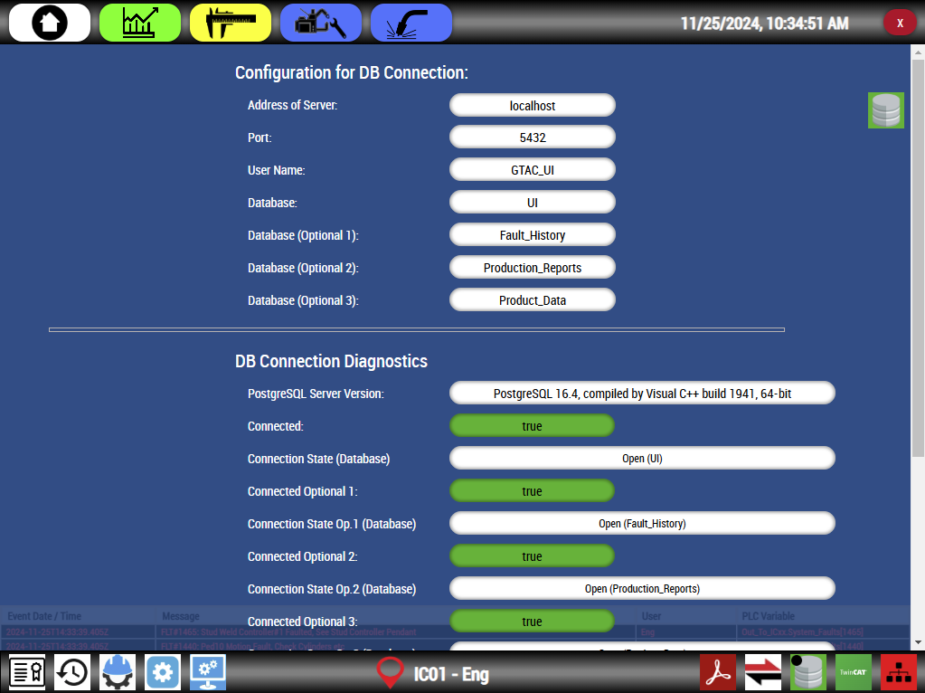
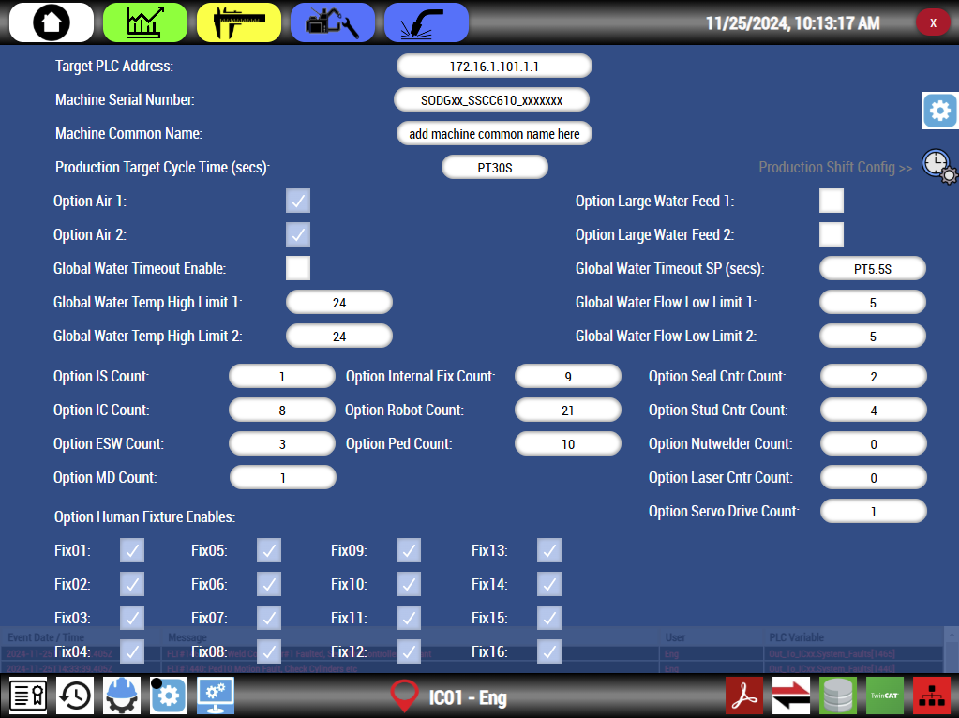
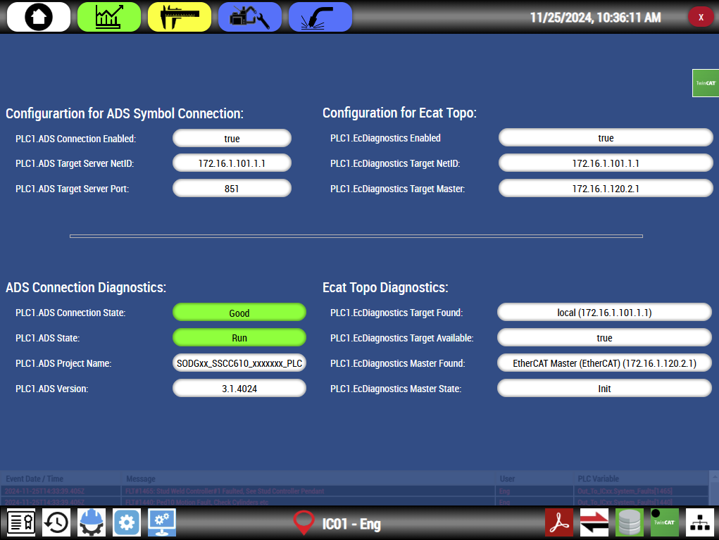
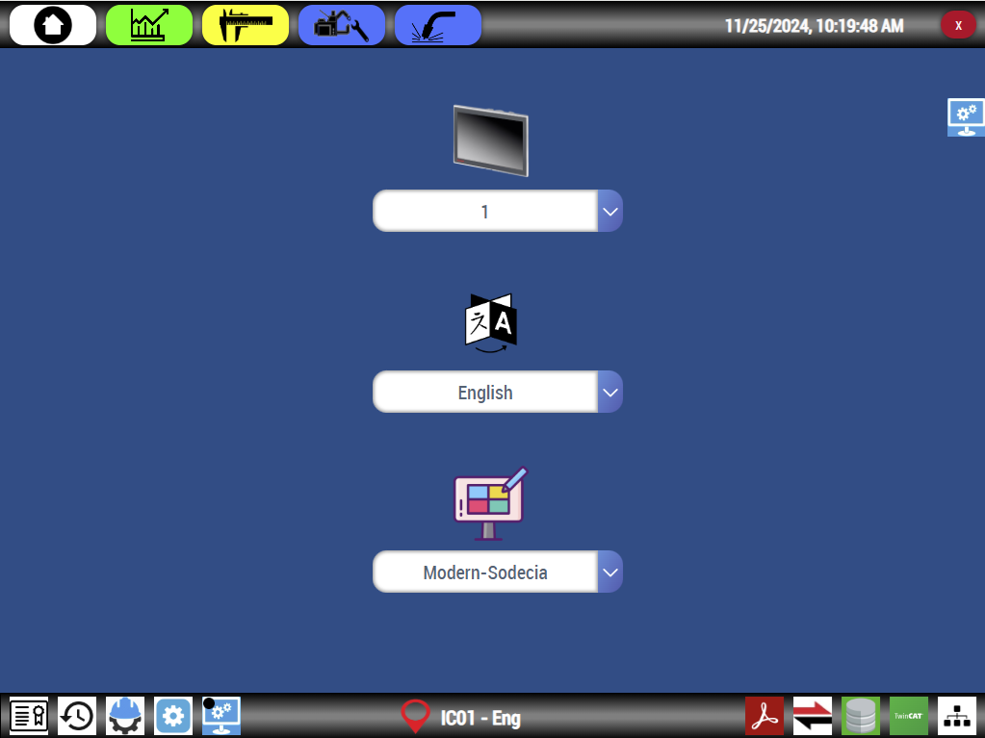
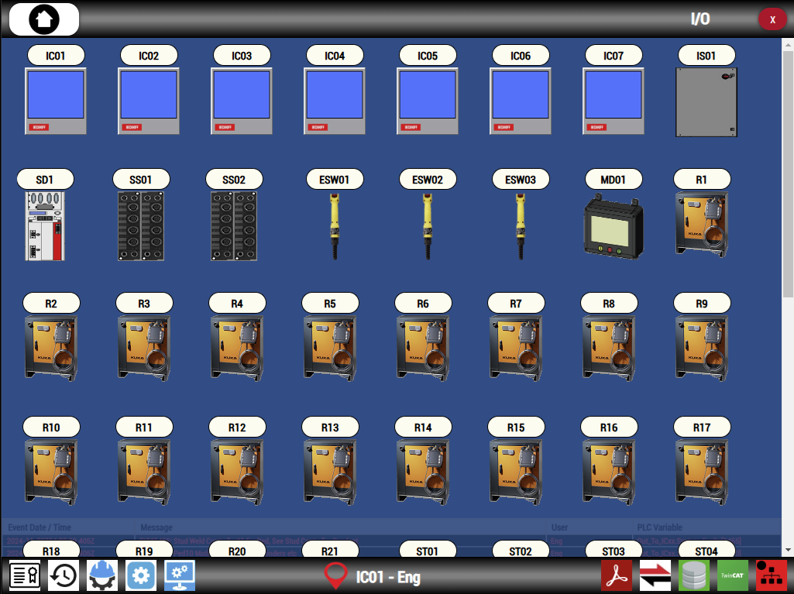
The Utility Menu
The Utility Menu gives
quick, icon based, access
to content such as:
License Notes
Rev Log
eGTAC
GTAC_Config Information
UI Configuration
Login Access / Status
Adobe Reader
Ecat Topo
Database Information
TwinCAT Information
Controls Overview

Slide 18
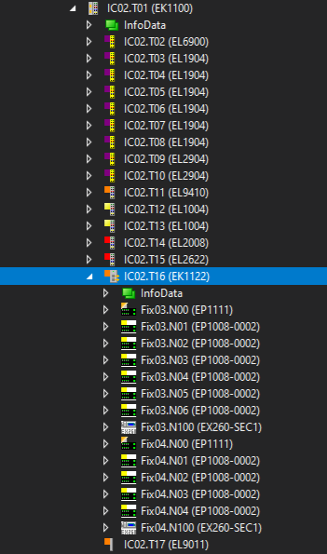
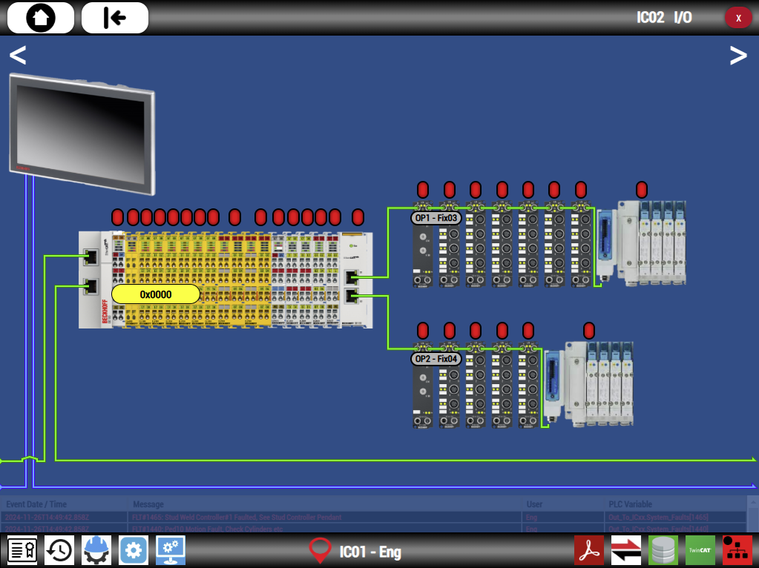
New Features
Auto Configuring Fixture I/O Symbols

Slide 19
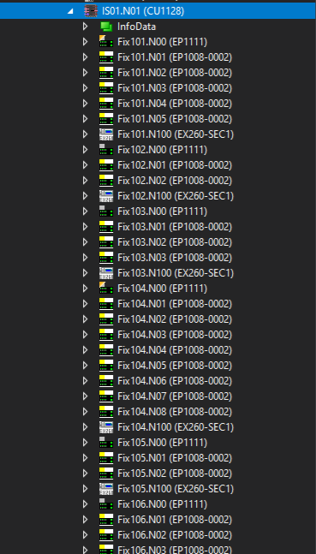
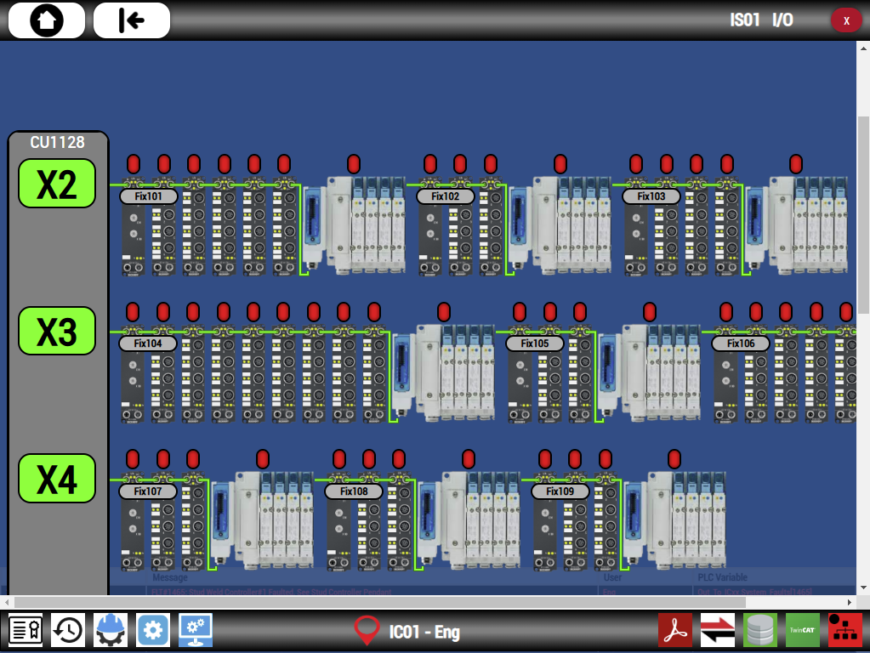
New Features
Auto Configuring Fixture I/O Symbols (cont’d)

Slide 20
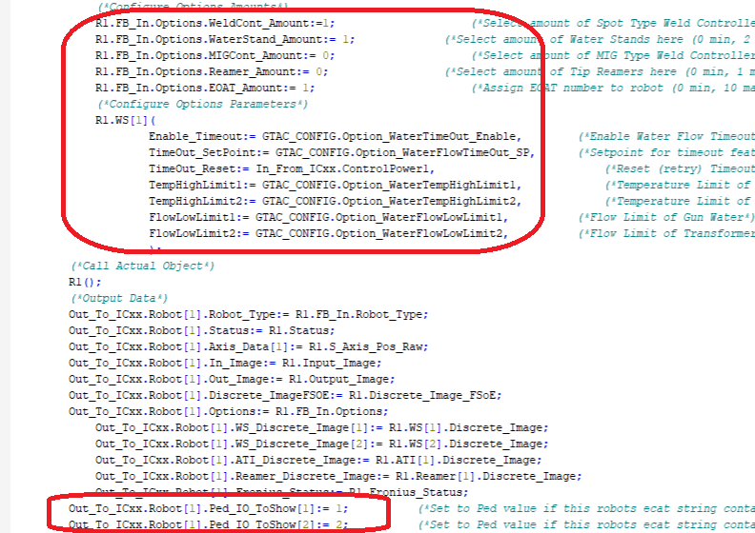
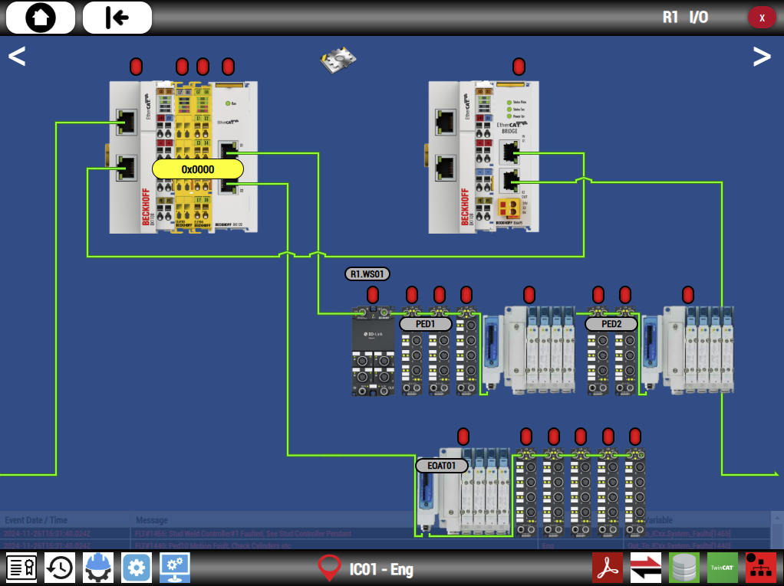
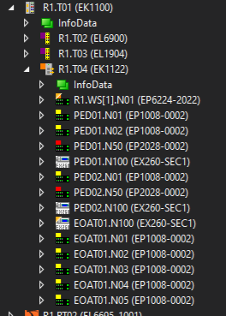
New Features
Auto Configuring Robot Attached I/O Symbols

Slide 21
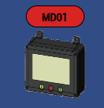
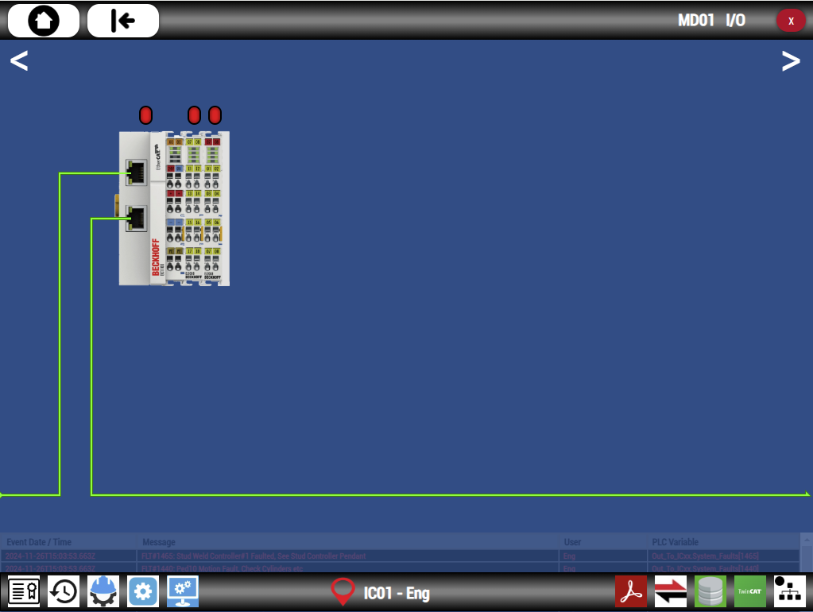
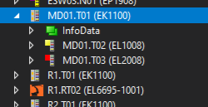
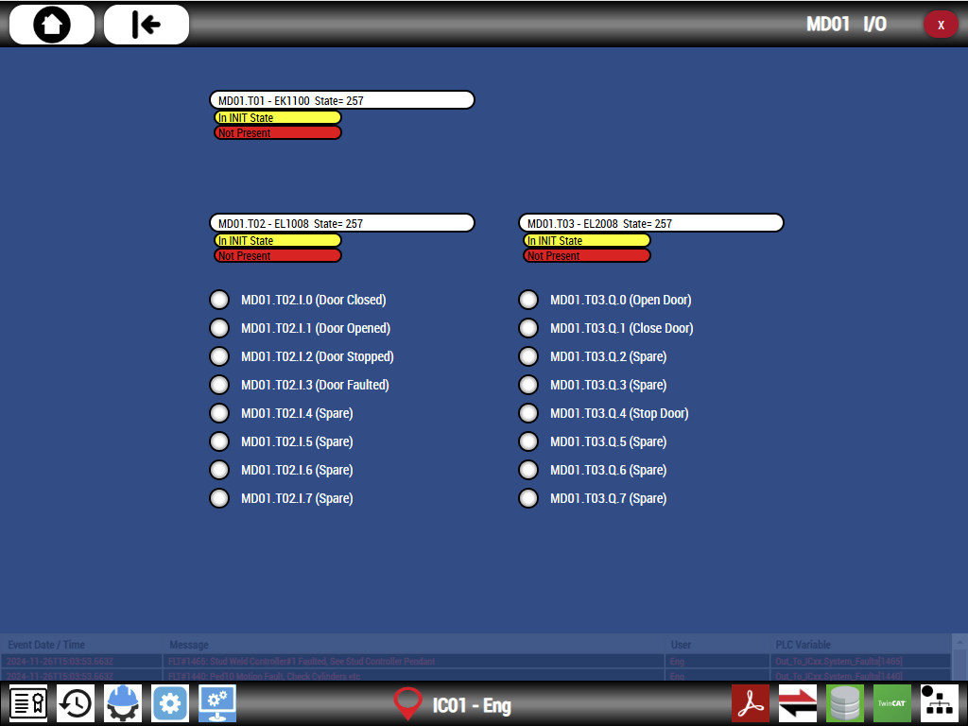
New Features
New MDxx Component
(Motorized Door, AKA Roll Door)

Slide 22
Deployment Work
New Features are great, especially if you don’t have to think about them and they reduce your workload, but let’s explore some topics you will still have to manually develop and configure:
Configure multiple ICs (in cases where there is more then one IC)
Line Overview Screen(s)
Fixture Screens
Fault Message Updating
Localizations (Translations)
Change Interface between PLC <-> UI

Slide 23

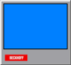

Deployment Work,
Multiple ICs
Handling Multiple ICs
Development PC deploys PLC + UI to IC01 only
IC01
IC02
Client ICs (IC02+) simply use a Web Browser to access the UI server on IC01

Slide 24
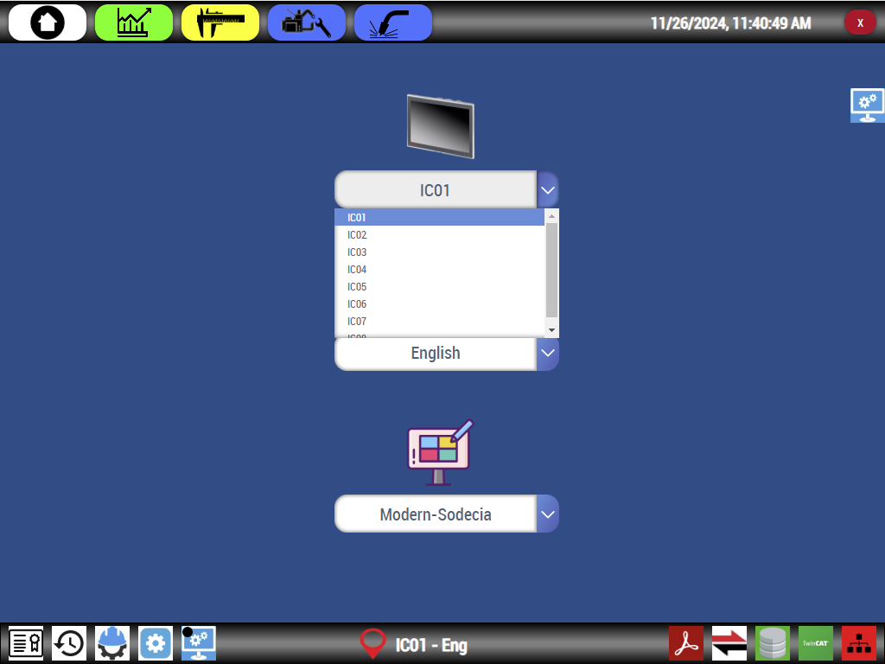
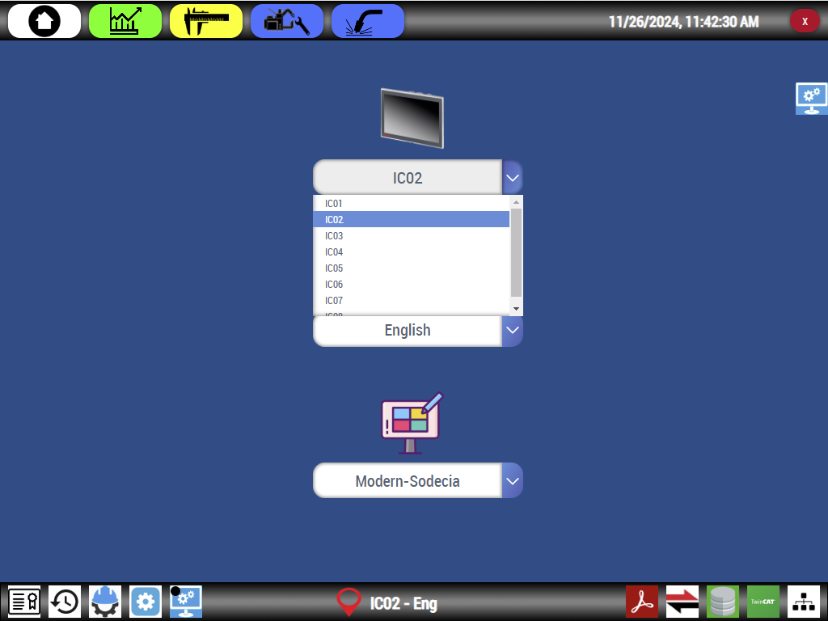
Deployment Work,
Multiple ICs
Handling Multiple ICs (cont’d)
IC01
IC02
On the UI Configuration Page, simply set the IC number

Slide 25

Deployment Work
New Features are great, especially if you don’t have to think about them and they reduce your workload, but let’s explore some topics you will still have to manually develop and configure:
Configure multiple ICs (in cases where there is more then one IC)
Line Overview Screen(s)
Fixture Screens
Fault Message Updating
Localizations (Translations)
Change Interface between PLC <-> UI

Slide 26
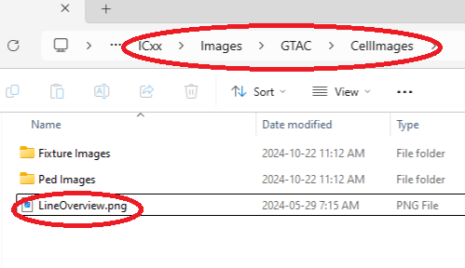
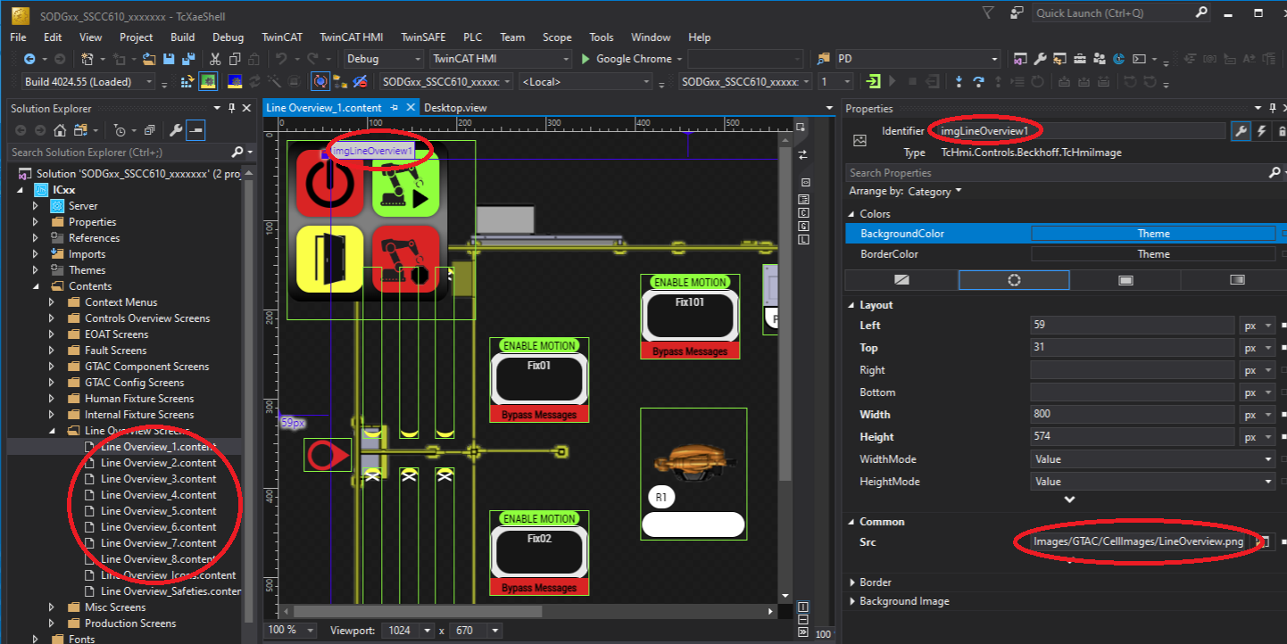
Deployment Work,
Line Overview Content
To start, the background image can be changed by updating the “LineOverview.png” file located at
ICxx/Images/GTAC/CellImages.
This image is referenced in all the Line Overview content files.

Slide 27
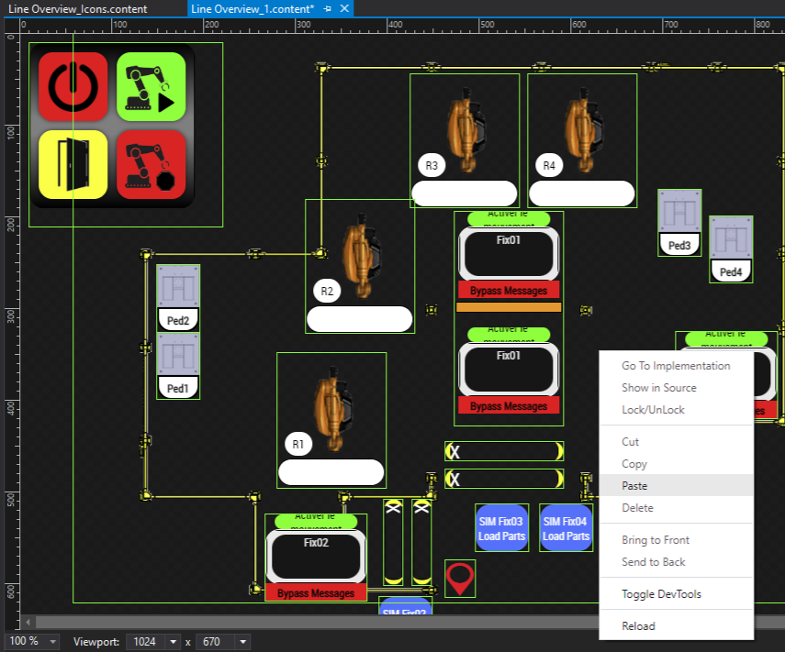
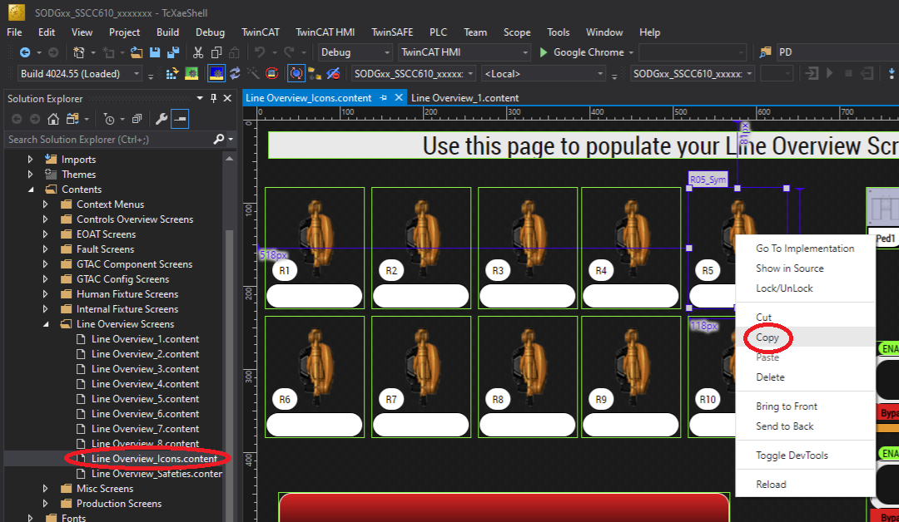
Deployment Work,
Line Overview Content
Continue updating your Line Overview content. Move items around to fit your new background image. A Line Overview Icons content has been pre-created so you can simply copy and paste commonly used objects onto your final Line Overview content.

Slide 28
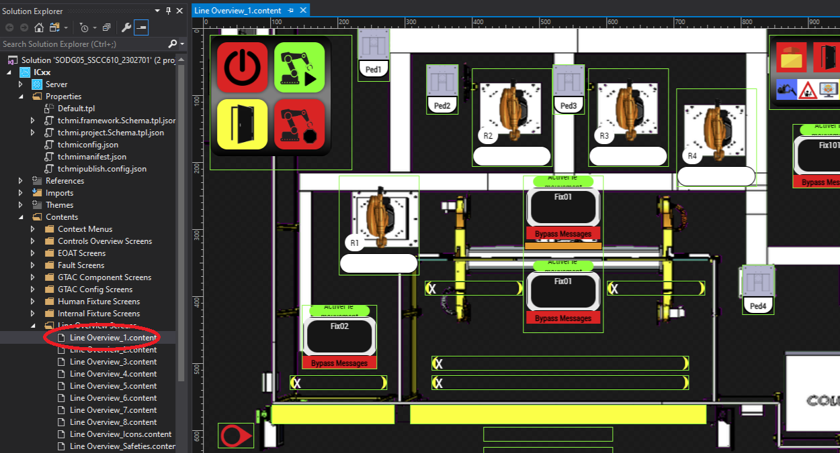

Deployment Work,
Line Overview Content
Different Line Overview contents can be created for different IC perspectives. For example, the physical location of IC01 might offer a different view of the machine. The Line Overview content files are numbered according to which IC will use the content as its default.
Line Overview_1.content
IC01 Default Line Overview Screen

Slide 29


Deployment Work,
Line Overview Content
Different Line Overview contents can be created for different IC perspectives. For example, the physical location of IC01 might offer a different view of the machine. The Line Overview content files are numbered according to which IC will use the content as its default.
Line Overview_3.content
IC03 Default Line Overview Screen

Slide 30
Deployment Work
New Features are great, especially if you don’t have to think about them and they reduce your workload, but let’s explore some topics you will still have to manually develop and configure:
Configure multiple ICs (in cases where there is more then one IC)
Line Overview Screen(s)
Fixture Screens
Fault Message Updating
Localizations (Translations)
Change Interface between PLC <-> UI

Slide 31


Similar to how we updated the Line Overview image, the Fixture background image can be changed by updating the applicable fixture image file located at:
ICxx/Images/GTAC/CellImages/Fixture Images
Each Image is referenced by the entire set of fixture contents for that fixture. In the example below, you can see Fix02, 03 and 04 image files have been updated.
Deployment Work,
Fixture Content

Slide 32

Deployment Work,
Fixture Content
With the Image file updated, you may now start customizing the fixture screen set found below.

Slide 33

We will start with the Cylinders_1.content.
Resize / move the image object to render a nice view of your new image. Then arrange / add / remove Actuator objects as required. Be sure to update the Identifier if you add objects. Also to the right are 5 parameters you can edit to tie the actuator object to the correct PLC variables, adjust the text of the object and change its scale (display size)
Deployment Work,
Fixture Content

Slide 34


In the previous slide, you may have noticed two of the Actuator object parameters seem to edit text values that do nothing. Deploy the project, navigate to the proper fixture screen and then click the actuator. The use of these two parameters will become obvious! Click the popup or navigate away from the screen and it will fly off the screen.
Deployment Work,
Fixture Content

Slide 35

Let us move onto the Sensors_1.content.
Again, resize / move the image object to render a nice view of your new image, for consistent page changing between fixture screens, it’s good practice to make the image object’s size and location consistent between all fixture content files of the same fixture. Finally, arrange / add / remove Sensor Indicator objects as needed. Once again, update the Identifier and parameters as required.
Deployment Work,
Fixture Content

Slide 36

Onto the Manual content files. You will note there are
3 manual content files, one is designated for each valve bank that might exist on your fixture, we will work on Manual_1.content only in the following example.
Below is an example of the Manual_1.content before any edits.
Deployment Work,
Fixture Content

Slide 37

Deployment Work,
Fixture Content
Click on the Valve object currently labeled Clamps 1,2,3,4.
Go ahead and edit the Valve Description parameter to enter a description appropriate for your application. Continue with editing the Description for all the valves required on your fixture, leave all other unused valves as “Spare”.

Slide 38

Deployment Work,
Fixture Content
In the example below you can see our fixture has four used valves in its valve bank. Best practice is to ensure your valve naming is consistent with the naming called out in the Fix IO and Seq.xlsx document associated with your machine.

Slide 39

Deployment Work,
Fixture Content
To finalize the Manual content, decide on what optional functions the end user may need. If any of the standard functions are not needed, simply set the object’s Visibility to “Collapsed”.

Slide 40

Deployment Work,
Fixture Content
Note that once an Object’s visibility is set to collapsed, the only way to access it again is by selecting the “Show Document Outline” button…..

Slide 41



You may be wondering why we didn’t mention the EcatSlaves_1 and Fixture QA_1 content files.
The EcatSlaves content auto configures itself based on the fixture parameters setup in the PLC code.
The QA content is edited in the same manner as the Cylinder / Sensor contents except we only add objects designated by the customer as QA Critical.
Deployment Work,
Fixture Content

Slide 42
Deployment Work
New Features are great, especially if you don’t have to think about them and they reduce your workload, but let’s explore some topics you will still have to manually develop and configure:
Configure multiple ICs (in cases where there is more then one IC)
Line Overview Screen(s)
Fixture Screens
Fault Message Updating
Localizations (Translations)
Change Interface between PLC <-> UI

Slide 43

During the application development process, there may become the need to edit or update fault messages. New to 6.10 we now store and retrieve our fault messages from a local Database. Let’s explore the example of adding in a new custom message:
Deployment Work,
Fault Messages

Slide 44


Our local Database is served through a product called PostgreSQL, the administrative tool to interact with the Database is called Postgres (Elephant icon). Double click pgAdmin and log into the Database Server. Navigate to the UI Database then drill down to Schemas -> public -> Tables -> alarm_messages
Right click the alarm_messages table and select “View/Edit Data” then “All Rows”
Deployment Work,
Fault Messages

Slide 45




Deployment Work,
Fault Messages
Scroll down through the resultant table data until you get to the fault message you want to edit (in our case Fault 1639). Double click to launch the editor, edit the text as required then click ok.
To finalize the edit, simply select the “Save Data Changes” bottom, done! Now let’s test…..

Slide 46


Ensure your PLC and UI (TcHmi) projects are deployed, log into the PLC and force the new fault, check to ensure the new fault message is displayed properly on the UI fault content.
Once you are done editing the fault messages in the Database, it is good practice to backup the database, details of this can be found in the FW Getting Started guide
Deployment Work,
Fault Messages

Slide 47
Deployment Work
New Features are great, especially if you don’t have to think about them and they reduce your workload, but let’s explore some topics you will still have to manually develop and configure:
Configure multiple ICs (in cases where there is more then one IC)
Line Overview Screen(s)
Fixture Screens
Fault Message Updating
Localizations (Translations)
Change Interface between PLC <-> UI

Slide 48




In our TcHmi project onscreen text is broken up into three groups as per below.
The Fault Messages and Fieldbus I/O naming are all retrieved from the Database and the rest is dealt with internally to the TcHmi project.
Deployment Work,
Localizations

Slide 49


Since the fault messages are retrieved by TcHmi from our PostgreSQL Database, we can simply used pgAdmin to edit these messages, no different then how we learned to edit fault messages in the previous slides.
Deployment Work,
Localizations
At time of writing there are no translations for the fieldbus messages (soon to come).

Slide 50

For general text on the UI that is not retrieved from the Database, we use Locale Keys as a variable that is changed based on the localization setting (what language is selected. In the example below the final UI text phrase “Total Parts Made” is stored in a locale key called TotalPartsMade.
Deployment Work,
Localizations

Slide 51


When we open the Localization Configurations we can see the keys and corresponding text phrase. Below, on the left, we see our TotalPartsMade key and the text phrase that will be used when the English language is selected “Total Parts Made”.
On the right we see the same key / phrase pair in the Portuguese Localizations configuration.
When the Portuguese language is selected, the phrase “Total de Pecas” will be used.
Deployment Work,
Localizations

Slide 52

To update an existing key, we can simply edit the corresponding phrase for the language(s) we want updated.
Deployment Work,
Localizations

Slide 53

If you need to create a new Key / Phrase pair, you can simply start at the bottom of the English Localization and double click the empty row.
Deployment Work,
Localizations

Slide 54

Give you key a descriptive name and then enter the English phrase you’d like to be shown when the UI is set to “English”
Deployment Work,
Localizations

Slide 55


Now, select the next language you want to add a translation for, for the same key. Be sure the “Show Missing Keys” check box at the top is checked, then scroll to the bottom, you’ll see the new key you added in the English Localization. Add in the appropriate translated phrase.
Deployment Work,
Localizations

Slide 56

With the Key / Phrase pair made you’re now free to use the key to drive the text attribute of on-screen objects. Below we added a small text box and added the new localization key to the text box’s text attribute.
Deployment Work,
Localizations

Slide 57




The textbox’s phrase will change based on the currently selected language.
Deployment Work,
Localizations

Slide 58
Deployment Work
New Features are great, especially if you don’t have to think about them and they reduce your workload, but let’s explore some topics you will still have to manually develop and configure:
Configure multiple ICs (in cases where there is more then one IC)
Line Overview Screen(s)
Fixture Screens
Fault Message Updating
Localizations (Translations)
Change Interface between PLC <-> UI

Slide 59

To use new variables from TwinCAT in TCHMI, they must be mapped in the TCHMI Server Configuration Window.
Start by adding them to In_From_ICxx or Out_From_ICxx. Variables shared between PLC and HMI should exclusively be organized into these UDTs. The variable we will use in this example will be a global variable called tchmivar.
Deployment Work,
Changing the Interface
between PLC and UI

Slide 60

Open the TwinCAT HMI Server Configuration window by going to TwinCAT HMI>Windows>TwinCAT HMI Server Configuration
Deployment Work,
Changing the Interface
between PLC and UI

Slide 61




Make sure you have the target HMI project sleected (if you have a PLC window upon, nothing will show up)
Deployment Work,
Changing the Interface
between PLC and UI

Slide 62

Under “All Symbols”, expand ADS to find In_From_ICxx or Out_To_ICxx. Right click the one you’ve updated and click “Refresh Mapping”. It should now be useable in the TCHMI project.
Deployment Work,
Changing the Interface
between PLC and UI

Slide 63
Deployment Work
New Features are great, especially if you don’t have to think about them and they reduce your workload, but let’s explore some topics you will still have to manually develop and configure:
Configure multiple ICs (in cases where there is more then one IC)
Line Overview Screen(s)
Fixture Screens
Fault Message Updating
Localizations (Translations)
Change Interface between PLC <-> UI

Slide 64

Q&A

Slide 65

Thanks for your time

